Slide 1
Sessions 4-5: Process Management

Slide 2
Program and Process
Program (Passive, On the Disk)
Set of instructions to solve a problem, written in a programming language
Process (Active, in Memory)
When a program starts running, it becomes a process; which means the operating system has to track it
Execute

Slide 3
Process Concept
A process is a program in execution. It is a unit of work within the system. Program is a passive entity, process is an active entity.
Process needs resources to accomplish its task
CPU, memory, I/O, files
Initialization data
Process termination requires reclaim of any reusable resources
Typically system has many processes, some user, some operating system running concurrently on one or more CPUs
Concurrency by multiplexing the CPUs among the processes / threads

Slide 4
Process
Process
Registers
Memory

Slide 5

Process versus Thread
Imagine that we are given some artists and are asked to draw this picture

Slide 6

Process versus Thread
Three artists are given three separate pieces of paper

Slide 7

Process versus Thread
Three artists draw different parts of the picture

Slide 8

Process versus Thread
Different parts are combined by using glue, manually

Slide 9
Process versus Thread
Important points about a process
“Heavy”
Has its own memory space
Runs completely independently
Has its own set of CPU registers
Other processes do not interfere with it

Slide 10

Process versus Thread
Now all the artists draw on the same paper

Slide 11
Process versus Thread
Important points about threads
“Lightweight”
A thread is a part of a process
Every process has at least one thread
A process can run one thread or multiple threads
Threads share the process code, data, files
Each thread has its own stack and registers

Slide 12
Why Multithreading?
By default, programs are executed in sequence, line-by-line
public static void main (String args []) {
initializeArrays ();
downloadData ();
buildModel ();
makePredictions ();
}
Operation 1
In a single-threaded application, these will be executed one after another … What if the downloadData () step takes 15 minutes?
Operation 2
Operation 3
We can make it multi-threaded, so that time-consuming tasks do not block other tasks
Operation 4

Slide 13
Why Multithreading?
Responsiveness (Concurrency)
If we have a single web server instance running, only one user’s request can be fulfilled
With multithreading, we can spawn many threads to handle concurrent requests
Performance (Parallelism)
We can create an illusion with even a single core that multiple tasks are executing in parallel
Complete complex tasks much faster
Do more in less time

Slide 14
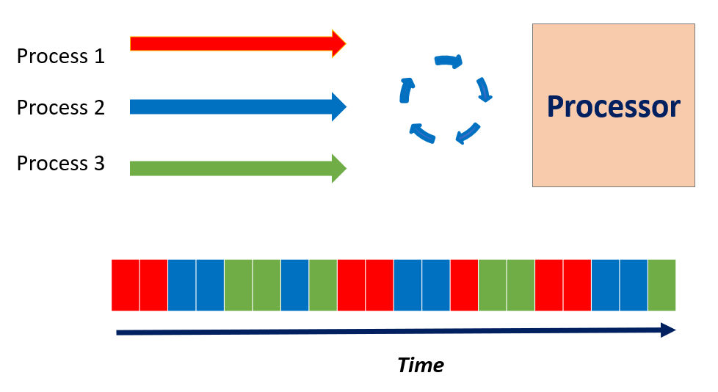
Many Processes, One Processor (CPU)

Slide 15
Process Management
Creating and deleting both user and system processes
Suspending and resuming processes
Providing mechanisms for process synchronization
Providing mechanisms for process communication
Providing mechanisms for deadlock handling

Slide 16
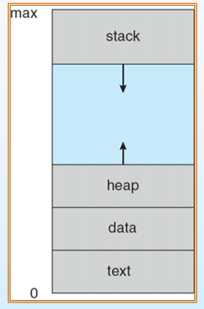
Process in Memory
A process includes:
program counter
stack
data section

Slide 17
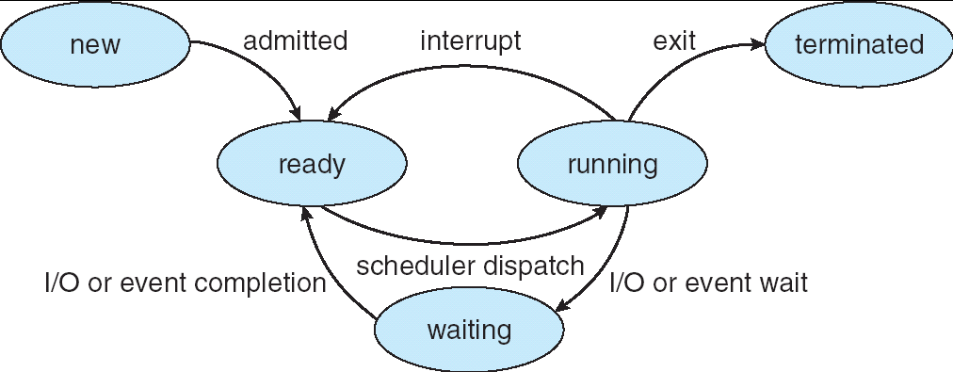
Process States
new: The process is being created
running: Instructions are being executed
waiting: The process is waiting for some event to occur
ready: The process is waiting to be assigned to a processor
terminated: The process has finished execution

Slide 18
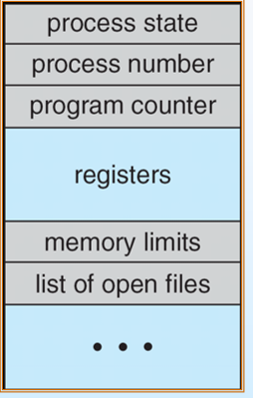
Process Control Block (PCB)

Slide 19
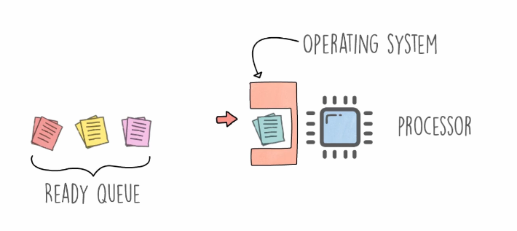
Process Scheduling
Process scheduling Remove the running process from the CPU and select another process on the basis of a particular strategy.
Process scheduling is an essential part of a Multiprogramming operating system.
Such operating systems allow more than one process to be loaded into the executable memory at a time and loaded processes share the CPU one after the other using time multiplexing.

Slide 20
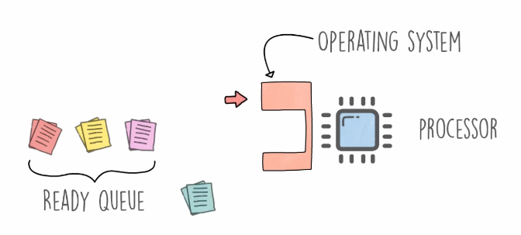
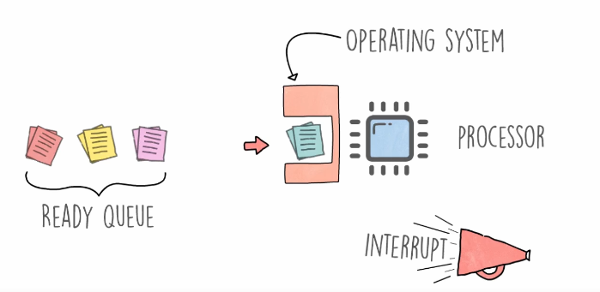
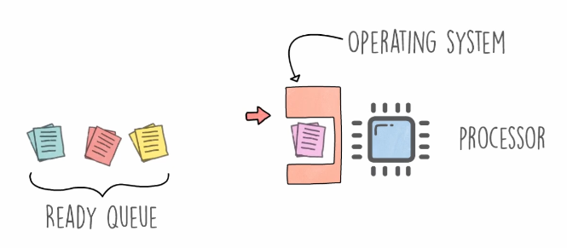
Process Scheduling
A process is running
An interrupt occurs (either in the running process, or the OS interrupts)
The operating systems moves the running process to the ready queue
The next ready process starts running

Slide 21
Scheduling Queues
Scheduling queues refers to queues of processes or devices.
When a process enters into the system, then this process is put into a scheduling queue (also called as job queue).
This queue consists of all processes in the system.
The operating system also maintains other queues such as device queue. Device queue is a queue for which multiple processes are waiting for a particular I/O device. Each device has its own device queue.

Slide 22
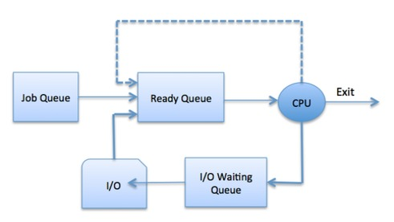
Process Scheduling

Slide 23
Scheduling Queues
A newly arrived process is put in the ready queue. Processes wait in ready queue for the CPU. Once the CPU is assigned to a process, then the selected process will execute.
While executing the process, any one of the following events can occur.
The process could issue an I/O request and then it would be placed in an I/O queue.
The process could create new sub process and will wait for its termination.
The process could be removed forcibly from the CPU, as a result of interrupt and put back in the ready queue.

Slide 24
Scheduler Types
A scheduler is a special type of system software which handles process scheduling in various ways. Its main task is to select the jobs to be submitted into the system and to decide which process to run.
Schedulers are of three types
Long Term Scheduler
Short Term Scheduler
Medium Term Scheduler

Slide 25
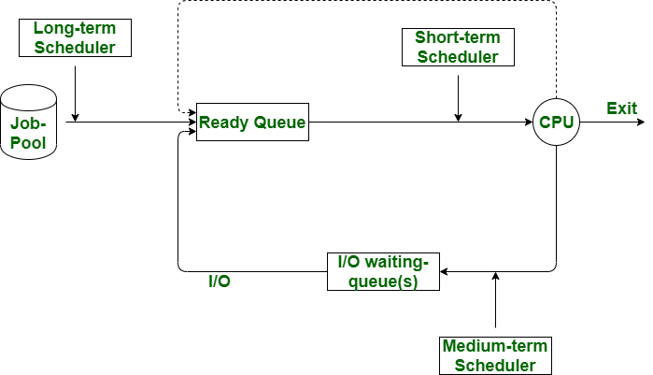
Scheduler Types

Slide 26
Long Term Scheduler
It is also called job scheduler.
Long term scheduler determines which programs are admitted to the system for processing.
Long term/Job scheduler selects processes from the queue and loads them into memory for execution.
Process loads into the memory for CPU scheduling.
The primary objective of the job scheduler is to provide a balanced mix of jobs, such as I/O bound and processor bound.
It also controls the degree of multiprogramming (Number of new processes and departing processes).

Slide 27
Short Term Scheduler
It is also called CPU scheduler.
Main objective is increasing system performance in accordance with the chosen set of criteria. It is in charge of moving a ready state process to the running state.
CPU scheduler selects process among the processes that are ready to execute and allocates CPU to one of them.
Short term scheduler also known as dispatcher, executes most frequently and makes the fine grained decision of which process to execute next.
Short term scheduler is faster than long term scheduler.

Slide 28
Medium Term Scheduler
Medium term scheduling is part of the swapping (Explained below).
It removes the processes from the memory.
It reduces the degree of multiprogramming.
The medium term scheduler is in-charge of handling the swapped out-processes.
Swapping: Running process may become suspended if it makes an I/O request. Suspended processes cannot make any progress towards completion. In this condition, to remove the process from memory and make space for other process, the suspended process is moved to the secondary storage. This step is called swapping, and the process is said to be swapped out or rolled out. (See next slide)

Slide 29
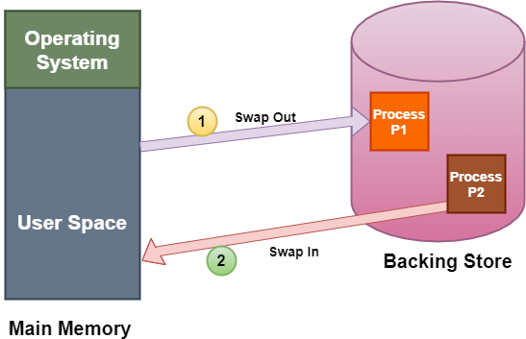
Swapping

Slide 30
CPU Scheduling (i.e. Short Term Scheduling)
Resources: the things operated on by processes.
Resources ranges from CPU time to disk space, to I/O channel time.
Resources fall into two classes:
Preemptive: OS can take resource away. Use it for something else, and then give it back later.
Examples: processor
Non-preemptive: Once given, it cannot be reused until the process gives it back.
Examples: file, terminal
Anything is preemptive if it can be saved and restored.

Slide 31
Criteria for a Good CPU Scheduling Algorithm
1. Fairness: Every process gets its fair share of CPU (i.e. time slice).
2. Efficiency (utilization): Keep CPU busy.
3. Response time: Minimize response time for interactive users.
4. Throughput: Maximize jobs per hour.
5. Minimize overhead (Context switch).

Slide 32
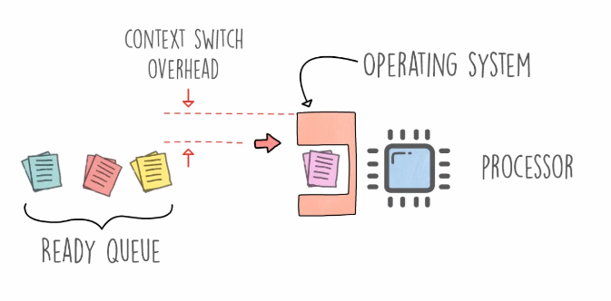
Context Switch

Slide 33
Scheduling Algorithms
First-Come First-Served (FCFS)
Round Robin (RR)
Priority
Shortest Job First (SJF)

Slide 34
Preemptive and Non-preemptive Algorithms
Preemptive algorithm
An algorithm that can be interrupted by an operating system if there is a need to do so
This means that if a process is a part of a preemptive algorithm, then while it is running, it can be interrupted
Non-preemptive algorithm
An algorithm that cannot be interrupted by an operating system even if there is a need to do so
This means that if a process is a part of a non-preemptive algorithm, then while it is running, it cannot be interrupted

Slide 35
First Come First Serve (FCFS)
Also called First In First Out (FIFO)
FCFS is simplest of CPU Scheduling Algorithms, which executes the process that comes first.
It is non-preemptive algorithm.
Process that comes in ready queue first gets to be executed by the CPU first, then second one, then third one, and so on.
The arrival time of processes is deciding factor here.

Slide 36
Measuring Process Timings
Arrival time: Time when the process arrived in the process queue
Burst time: The CPU time used by the process
Completion time: The time at which the process got completed
Turn around time: The time at which the process got completed minus the time at which the process entered the system
Waiting time: The time for which the process needed to wait, due to lack of CPU attention
Turn Around Time = Completion Time - Arrival Time
Waiting Time = Turnaround time - Burst Time

Slide 37
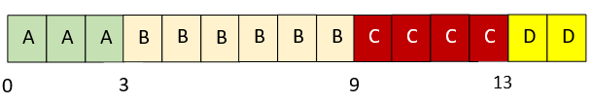
Example
Consider the following processes and draw a chart showing the FCFS execution
Process | Arrival Time | Processing Time
A | 0.000 | 3
B | 1.001 | 6
C | 4.001 | 4
D | 6.001 | 2

Slide 38
Example
Consider the following processes and calculate average turnaround time and waiting time in FCFS
Turnaround time = Terminated time – Arrival time
= ( (3-0) + (9-1) + (13-4) + (15-6) ) / 4 = 7.25
Waiting time = Turnaround time – Processing/Execution time
A: 3 - 3 = 0 B: 8 - 6 = 2 C: 9 -4 = 5 D: 9 – 2 = 7
Process | Arrival Time | Processing Time
A | 0.000 | 3
B | 1.001 | 6
C | 4.001 | 4
D | 6.001 | 2

Slide 39
Round Robin (RR)
The Round Robin (RR) scheduling algorithm is a preemptive scheduling algorithm.
It uses concept of time slice.
Process at the beginning of ready queue gets chance to be executed first but only for span of one time slice.
As new and more processes get added to ready queue, ongoing process gets preempted and gets added to end of ready queue.
Next process gets the chance, again for span of one time slice.
This algorithm is designed for time-sharing systems.

Slide 40
Round Robin (RR) – Key Points
If the process has a CPU burst of less than time slice, then as soon as it is over, the CPU resources are released voluntarily. The next process in the ready queue occupies the CPU.
If the CPU burst is larger than the slice, the timer will go off and the process is preempted, its state is saved by context switching and process is put at the end of the ready queue. After this, the next process in the ready queue takes over.

Slide 41
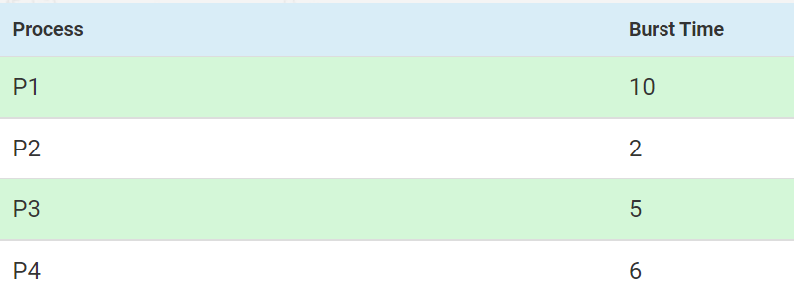
Round Robin (RR) Example
Consider 4 processes where time slice is 3
Calculate average waiting time

Slide 42
Explanation
P1 is executed for 3ms. Then P2 is executed. As, P2 is only 2ms long, So after 2ms, the next process occupies the CPU.
P3 then is executed for 3ms. So, P3 still needs 2ms. Then, P4 is executed for 3ms. P4 still needs 3ms.
P1 is again executed for 3ms. P1 still needs 4ms.
P3 is executed for 2ms. Then, P4 is executed for 3ms.
Now remaining process is P1 only. It executes for 3ms. After that, Since P2, P3 and P4 are already finished, P1 is executed again for remaining time (1ms).

Slide 43

Solution
P1 has utilized two 3ms time slices earlier, so we subtract 3 twice from its last start time
Waiting time for P1 = 19-(3+3) = 13ms
Waiting time for P2 = 3ms
Waiting time for P3 = 14-3 = 11ms
Waiting time for P4 = 16-3 = 13ms
Total average waiting time = (13+3+11+13)/4 = 10ms
Both P3 and P4 have utilized one time slice each, earlier, so we subtract 3 from them

Slide 44
Exercise
Consider the following processes and using RR (time slice = 2), draw the execution chart and calculate average turnaround time and average waiting time
Process | Arrival Time | Processing Time
A | 0.000 | 3
B | 1.001 | 6
C | 4.001 | 4
D | 6.001 | 2

Slide 45
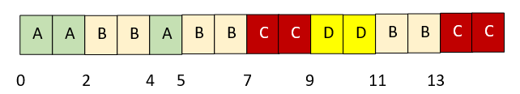
Solution
Process | Arrival Time | Processing Time
A | 0.000 | 3
B | 1.001 | 6
C | 4.001 | 4
D | 6.001 | 2
Test
Explanation: When process A’s first time slice expires, process B runs. At time4, process A is restarted and process B returns to ready queue. At time 4.001, process C enters the ready queue after process B. At time 5, process A terminates and process B runs. At time 6.001, process D enters the ready queue behind process C. At time 7, process C, D, B, and C run in sequence.
Average turnaround time = Terminated time – Arrival time
( (5-0) + (13-1) + (15-4) + (11-6) ) / 4 = 8.25
Average waiting time = Turnaround time – Processing time
A: 5 – 3 = 2 B: 12 – 6 = 6 C: 11 – 4 = 7 D: 5 – 2 = 3

Slide 46
Round Robin – Summary
Advantage:
It does not cause starvation, as all the processes get equal CPU time slices.
Disadvantages:
There is an overhead of context switching.
Too small time slices cause overhead and slower execution of processes. So, time slices must be large with respect to the context switch time.

Slide 47
Priority Scheduling
Priority scheduling is a non-preemptive algorithm and one of the most common scheduling algorithms in batch systems.
The process priorities are compared (low priority number means higher priority, i.e. priority 0 is the highest priority).
These steps are repeated.

Slide 48
Example
For the processes listed below, draw a chart showing their execution using priority scheduling. A larger number has higher priority. Consider (a) Preemptive and (b) Non-preemptive cases separately. Consider higher priority number = higher priority.
Process | Arrival time | Burst time | Priority
A | 0.000 | 4 | 3
B | 1.001 | 3 | 4
C | 2.001 | 3 | 6
D | 3.001 | 5 | 5

Slide 49
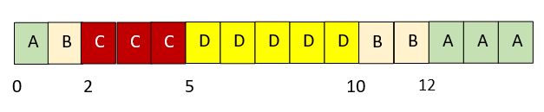
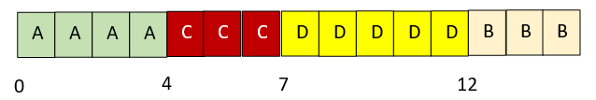
Solution
Preemptive case
Non-preemptive case
Process A runs until process B arrives. Process B preempts process A and runs until it is preempted by process C. After process C terminates, process D runs. After process D, the lower-priority process B and process A run.
Process A runs to completion. When it terminates, the other three processes are all waiting to run. They run in the order of their priority: C, D, and B.

Slide 50
Problem
For the same processes, calculate turnaround time for each process using priority scheduling
Preemptive
A: 15 – 0 = 15 B: 12 – 1 = 11 C: 5 – 2 =3 D: 10 – 3 = 7, Avg = (15 + 11 + 3 + 7) / 4 = 9
Non-preemptive
A: 4 – 0 = 4 B: 15 – 1 = 14 C: 7 – 2 = 5 D: 12 – 3 = 9, Avg = (4 + 14 + 5 + 9) / 4 = 8
Process | Arrival time | Burst time | Priority
A | 0.000 | 4 | 3
B | 1.001 | 3 | 4
C | 2.001 | 3 | 6
D | 3.001 | 5 | 5

Slide 51
Priority Scheduling – Points
A process having lower priority can be indefinitely blocked or starved.
To prevent this, we do aging, where the priority of the process is increased as it waits in the queue.
So, a process which has been in a queue for a long time will reach high priority, and hence it won’t be starved.

Slide 52
Shortest Job First (SJF)
Non pre-emptive algorithm
Selects the process with the shortest expected processing time
If there is a tie, FCFS is used
Favors short processes over longer ones
Can lead to starvation for a long process in extreme cases

Slide 53

Example
Consider the following processes and draw a chart showing the SJF execution
Process | Arrival Time | Processing Time
A | 0.000 | 3
B | 1.001 | 6
C | 4.001 | 4
D | 6.001 | 2
Explanation: A starts executing; it is the only choice at time 0. At time 3, B is the only process in the queue. At time 9, when B completes, process D runs because it is shorter than process C.

Slide 54
Example
Consider the following processes and calculate average turnaround time and waiting time for each process using the SJF algorithm
Turnaround time: ((3 – 0) + (9 – 1) + (15 – 4) + (11 – 6) / 4) = 6.75
Waiting time: A: (3 – 3) = 0; B: (8 – 6) = 2; C: (11 – 4) = 7; D: (5 – 2) = 3
Process | Arrival Time | Processing Time
A | 0.000 | 3
B | 1.001 | 6
C | 4.001 | 4
D | 6.001 | 2

Slide 55
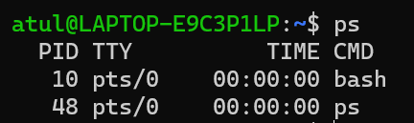
Linux and Process-related Commands
To find out which processes are running on Linux, we can use the ps command
To see a tree of the processes, we can use pstree

Slide 56
Process Creation Commands – fork, waitpid, and exec
It is a clone operation.
Here, the current process is taken and cloned.
So, now we have a parent process and a child process with two different process IDs.
Everything (sack, heap, file descriptors etc) are copied from the parent process to the child process. The two are independent processes now.
fork
Consider the shell. It reads a command from the terminal, forks off a child process, waits for the child process to execute the command, and then reads the next command when the child terminates.
To wait for the child to finish, the parent executes a waitpid system call.
waitpid
The child process must execute the command typed by the user. For this, the exec call is used. The entire core image of the process is replaced by the file named in its first parameter (see next slide).
exec

Slide 57
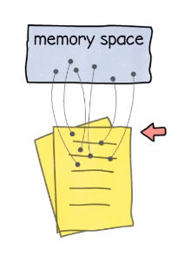
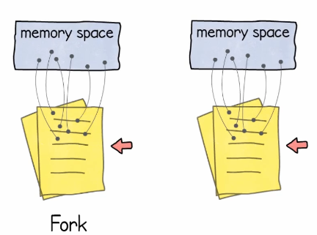
The fork operation
Original state
After fork

Slide 58
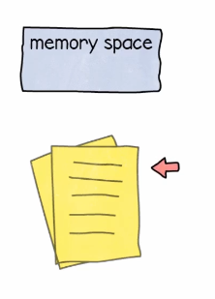
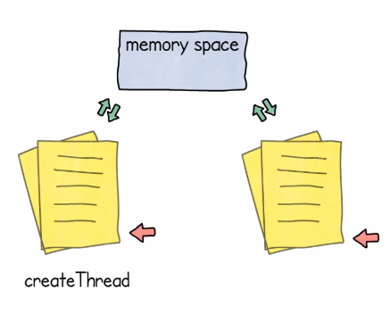
Thread Creation is Different!
Initial state
After Thread creation

Slide 59
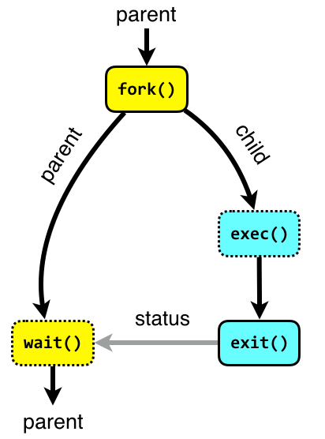
Illustration of fork, waitpid and exec

Slide 60
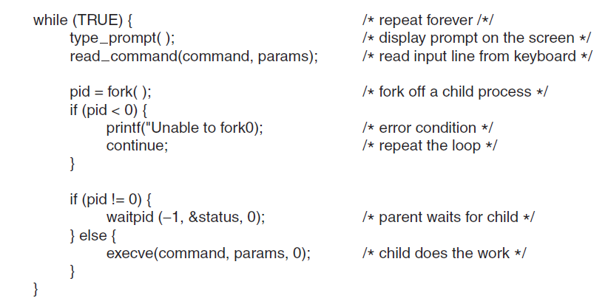
A Highly Simplified Shell

Slide 61
Zombie and Orphan Process
If a process exits and its parent has not yet waited for it, the process enters a kind of suspended animation called the zombie state—the living dead.
When the parent finally waits for it, the process terminates.
A process whose parent process no more exists i.e. has either finished or terminated without waiting for its child process to terminate is called an orphan process.

Slide 62
Linux Process Management
In Linux, a process can be run as a foreground process or background process
By default, all the processes are run in the foreground
When a process runs in the foreground, no other process can run in the terminal until the process is terminated or killed
When we add an ampersand (&) to a foreground command, it is run as a background process
When a process runs in the background, another process can run in the foreground

Slide 63
Linux Process Management Commands
Finding the status of a process: the ps command
ps
PID TTY TIME CMD
1524 pts/0 00:00:00 bash
1907 pts/0 00:00:00 ps
Find processes, including the background processes: ps –ef
ps -ef
UID PID PPID C STIME TTY TIME CMD
root 1 0 0 15:12 ? 00:00:02 /sbin/init splash
root 2 0 0 15:12 ? 00:00:00 [kthreadd]
root 3 2 0 15:12 ? 00:00:00 [rcu_gp]
root 4 2 0 15:12 ? 00:00:00 [rcu_par_gp]
…
ppid is the parent id of the current process
cmd is the command that started this process

Slide 64
Linux Process Management Commands
Finding all processes started by a user
ps –u atul

Slide 65
Linux Process Management Commands
Kill a process: the kill command
sudo Kill 1947
[sudo] password for atul:

Slide 66
Linux Process Types
Parent process
The parent of the current process
Child process
The child process created by a parent process
Orphan process
Sometimes when the parent gets executed before its own child process then the child process becomes an orphan process
The orphan processes have the init process (i.e. PID 0) as their PPID (parent process ID)
Zombie process
The processes, which are already dead but show up in process status are called Zombie processes
Zombie processes do not consume CPU
Daemon process
System-related processes that run in the background, and have ? In its TTY field

Slide 67
Illustration of fork, waitpid and exec

Slide 68
Process Creation Commands – fork, waitpid, and exec
It is a clone operation.
Here, the current process is taken and cloned.
So, now we have a parent process and a child process with two different process IDs.
Everything (sack, heap, file descriptors etc) are copied from the parent process to the child process. The two are independent processes now.
fork
Consider the shell. It reads a command from the terminal, forks off a child process, waits for the child process to execute the command, and then reads the next command when the child terminates.
To wait for the child to finish, the parent executes a waitpid system call.
waitpid
The child process must execute the command typed by the user. For this, the exec call is used. The entire core image of the process is replaced by the file named in its first parameter (see next slide).
exec

Slide 69
C Programs for Linux Process Demos
Install gcc in the Linux machine
sudo apt install gcc
Compile: gcc zombie.c
Execute: ./a.out
nano fork_test.c -l (The minus lowercase L flag shows line numbers)

Slide 70
fork_test.c
#include <stdio.h>
#include <unistd.h>
#include <sys/types.h>
#include <sys/wait.h>
/* This program forks and and the prints whether the process is
* - the child (the return value of fork() is 0), or
* - the parent (the return value of fork() is not zero)
*
* When this was run 100 times on the computer the author is
* on, only twice did the parent process execute before the
* child process executed.
*
* Note, if you juxtapose two strings, the compiler automatically
* concatenates the two, e.g., "Hello " "world!"
*/
int main( void ) {
char *argv[3] = {"Command-line", ".", NULL};
int pid = fork();
if ( pid == 0 ) {
execvp( "find", argv );
}
/* Put the parent to sleep for 2 seconds--let the child finished executing */
wait( 2 );
printf( "Finished executing the parent process\n"
" - the child won't get here--you will only see this once\n" );
return 0;
}

Slide 71
getpid.c
#include <stdio.h>
#include <unistd.h>
/* This program demonstrates that the use of the getpid() function.
*
* When this was run 100 times on the computer the author is
* on, only twice did the parent process execute before the
* child process executed.
*
* Note, if you juxtapose two strings, the compiler automatically
* concatenates the two, e.g., "Hello " "world!"
*
* The return value of fork() is actually pid_t ('pid' 't'ype).
* When it is assigned to 'int pid', if the type is different, there
* is an implicit cast; however, when we print the return value
* of getpid(), it is necessary to explicitly cast it as an
* integer.
*
* The type 'pid_t' is defined in the library header <sys/types.h>
*/
int main( void ) {
printf( "The process identifier (pid) of the parent process is %d\n", (int)getpid() );
int pid = fork();
if ( pid == 0 ) {
printf( "After the fork, the process identifier (pid) "
"of the child is %d\n", (int)getpid() );
} else {
printf( "After the fork, the process identifier (pid) "
"of the parent is still %d\n - fork() returned %d\n",
(int)getpid(), pid );
}
return 0;
}

Slide 72
exec.c
#include <stdio.h>
#include <unistd.h>
#include <sys/wait.h>
#include <sys/types.h>
/* This program forks and and the prints whether the process is
* - the child (the return value of fork() is 0), or
* - the parent (the return value of fork() is not zero)
*
* When this was run 100 times on the computer the author is
* on, only twice did the parent process execute before the
* child process executed.
*
* Note, if you juxtapose two strings, the compiler automatically
* concatenates the two, e.g., "Hello " "world!"
*/
int main( void ) {
char *argv[3] = {"Command-line", ".", NULL};
int pid = fork();
if ( pid == 0 ) {
execvp( "find", argv );
}
/* Put the parent to sleep --let the child finish executing */
wait( NULL );
printf( "Finished executing the parent process\n"
" - the child won't get here--you will only see this once\n" );
return 0;
}

Slide 73
Zombie Process Demo
zombie.c
The child finishes its execution using exit() system call while the parent sleeps for 50 seconds, hence doesn’t call wait() and the child process’s entry still exists in the process table.

Slide 74
zombie.c
// A C program to demonstrate Zombie Process.
// Child becomes Zombie as parent is sleeping
// when child process exits.
#include <stdlib.h>
#include <sys/types.h>
#include <unistd.h>
int main()
{
// Fork returns process id
// in parent process
pid_t child_pid = fork();
// Parent process
if (child_pid > 0)
sleep(50);
// Child process
else
exit(0);
return 0;
}

Slide 75
Orphan Process
A process whose parent process no more exists i.e. has either finished or terminated without waiting for its child process to terminate is called an orphan process.
Let us write a C program.
Here, the parent finishes execution and exits while the child process is still executing and is called an orphan process now.
However, the orphan process is soon adopted by init process, once its parent process dies.

Slide 76
orphan.c
// A C program to demonstrate Orphan Process.
// Parent process finishes execution while the
// child process is running. The child process
// becomes orphan.
#include<stdio.h>
#include <sys/types.h>
#include <unistd.h>
#include <stdlib.h>
int main()
{
// Create a child process
int pid = fork();
if (pid > 0) {
printf("in parent process");
exit (0);
}
// Note that pid is 0 in child process
// and negative if fork() fails
else if (pid == 0)
{
sleep(30);
printf("in child process");
}
return 0;
}

Slide 77
Find Zombie Processes
atul@atul-virtualbox:~/bash_course$ ps aux | grep 'Z'
USER PID %CPU %MEM VSZ RSS TTY STAT START TIME COMMAND
atul 1548 0.0 0.0 9076 2344 pts/0 S+ 18:37 0:00 grep --color=auto Z

